Slide 1
Deep dive in movie recommendation systems
From word similarity to neural collaborative filtering

Slide 2
On average an adult spends almost 4 hours a day watching content…
…and 51 minutes picking it
Source: 2017 Ericsson Consumer Lab Media Report

Slide 3
CONTENT FILTERING
Tf-idf, similarity, clustering
MEMORY BASED
Heuristic & non-parametric
COLLABORATIVE FILTERING
Tf-idf, similarity, clustering
RECOMMENDATION SYSTEMS
CONTENT FILTERING
Bayesians classifiers, neural networks
MODEL BASED
Algorithmic & parametric
COLLABORATIVE FILTERING
Bayesians networks, neural networks, SVD
Notes:
Memory based : uses the data that you have on users or contents to calculate “simple” similarities measures
Model based : create a model whose task is gonna be to guess how much an user is gonna like a content he has not seen yet
Content filtering : establishes similarities between contents → uses properties of the content and link similar ones to offer you recommendations
Collaborative filtering : establishes similarities between users → uses user data & behaviour to link you to other users that have seen the same movies that you have, and then recommands you the movies the others have seen but you have not

Slide 4
MEMORY BASED
COSINE & JACCARD SIMILARITIES
CONTENT FILTERING
A = “COOL PROJECT MAN”
B = “MAN WHAT A PROJECT”
A
B
A
MAN
WHAT
COOL
Cosine distance
PROJECT
A
B
Jaccard similarity
|Intersection|
=
=
2/5
|Union|

Slide 5
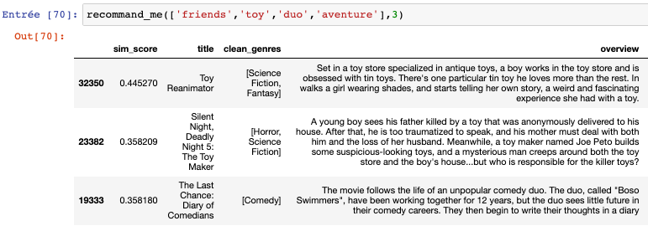
MEMORY BASED
DATASET N°1
CONTENT FILTERING
title | genre | overview | release date | runtime | rating
1
STEP 1
TF-IDF vectorization
VECTORIZE KEYWORDS
STEP 2
Cosine similarity
COMPUTE DISTANCE BETWEEN VECTORS
STEP 3
Output
Notes:
Drawback : repetitions have a lot of weight

Slide 6
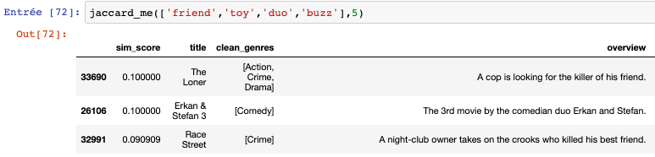
MEMORY BASED
DATASET N°1
CONTENT FILTERING
title | genre | overview | release date | runtime | rating
2
STEP 1
Jaccard similarity
MEASURE CARDINALITY SIMILARITY
STEP 2
Ouput
Notes:
Drawback : short sentences will weight more

Slide 7
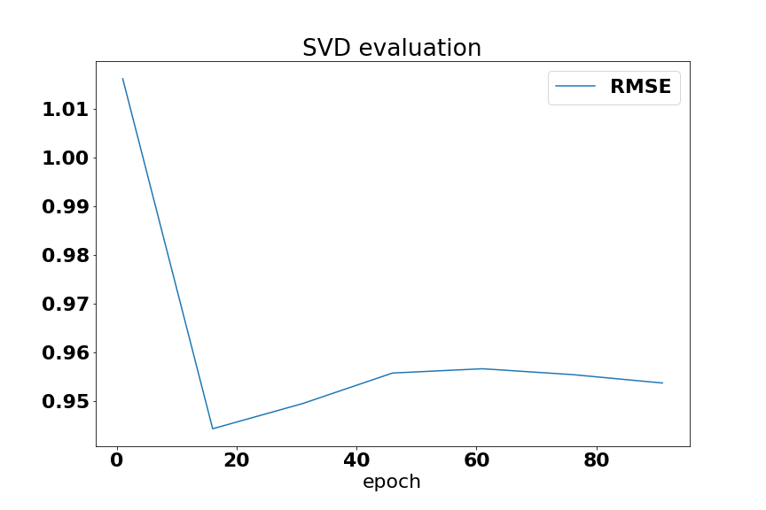
MODEL BASED
DATASET N°2: Movielens
COLLABORATIVE FILTERING
User Id | Movie Id | rating
1
Singular Value Decomposition (SVD)
Won the Netflix Prize in 2006 – $1M
Previous Netflix’s algorithm Cinematch had a 1.0540 RMSE

Slide 8
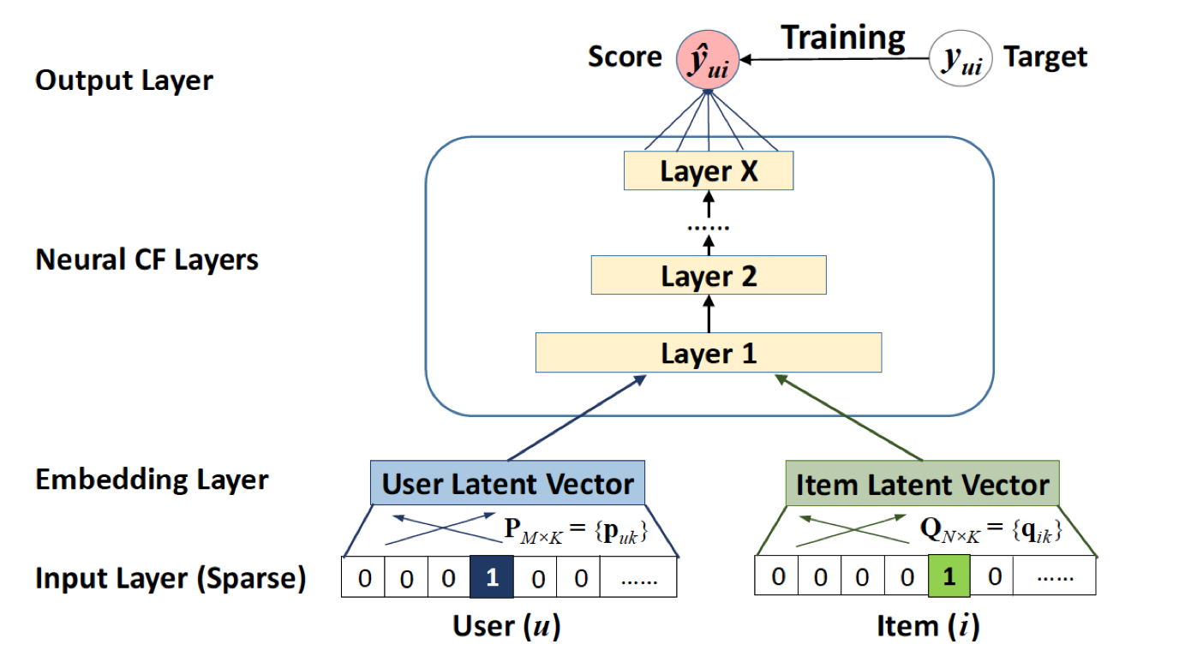
MODEL BASED
DATASET N°2: Movielens
COLLABORATIVE FILTERING
User Id | Movie Id | rating
2
Neural Collaborative Filtering (NCF)
Designed in 2017
Epochs | 1 | 51 | 101 | 151
RMSE | 0.15281 | 0.153234 | 0.149523 | 0.146766
Precision

Slide 9
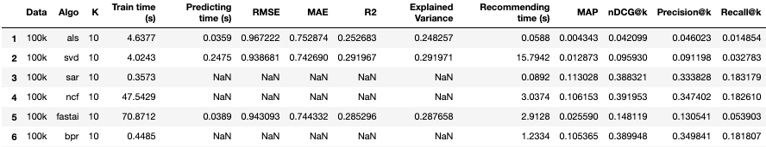
MODEL BASED
COLLABORATIVE FILTERING
BENCHMARK

Slide 10

